Slide 1

EMERGENCY AUTOMOBILE TECHNIAN SERVICE (MACHANIC KOTHAY ?)
GROUP - 07

Slide 2
MEMBERS
TAZRIAN ZAMAN TUSHTI ( 19-39433-1 )
KHANDAKER MD. TOUSIF ISLAM ( 19-39407-1 )
HASAN, SHADIK ( 19-39357-1 )
AFIQUE SADIQUE ( 19-39708-1 )

Slide 3
CONTENTS
IDEA GENERATION
USE CASE DIAGRAM
ACTIVITY DIAGRAM
USER INTERFACE OR MOCK DESIGN
JIRA
GIT
CLASS DIAGRAM
CODE
PROJECT SCHEDULING
EFFORT ESTIMATION & BUDGETING
CONCLUSION

Slide 4
IDEA GENERATION
Reconditioned vehicles are used more in Bangladesh. These cars can have mechanical problems at any time. Passengers suffer especially if there is a mechanical problem while driving on the highway. They can't find automobile technicians anywhere on the highway. That's why they have to rent another vehicle and take the wrecked vehicle. As a result they waste their valuable time as well as spend extra money.
To solve this problem, we are introducing a system through which the driver of the vehicle can get the service immediately by contacting with the nearest automobile technician via location sharing.
Those who drive vehicles are our target audience.
At present the total number of vehicles in Bangladesh 5004130.000 Unit [year 2019] . And whose number is increasing day by day. In addition, customers will be able to receive their desired service from the technician of their choice from home. As a result, customers do not have to go to any workshop with their vehicle.

Slide 5
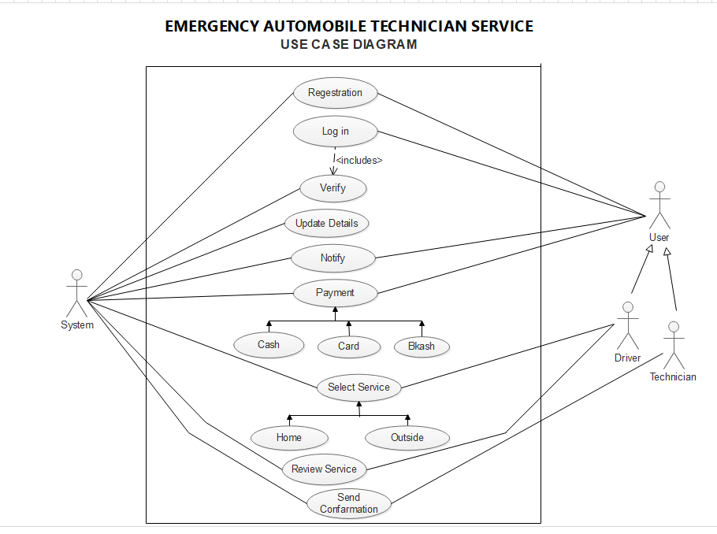
USE CASE DIAGRAM

Slide 6
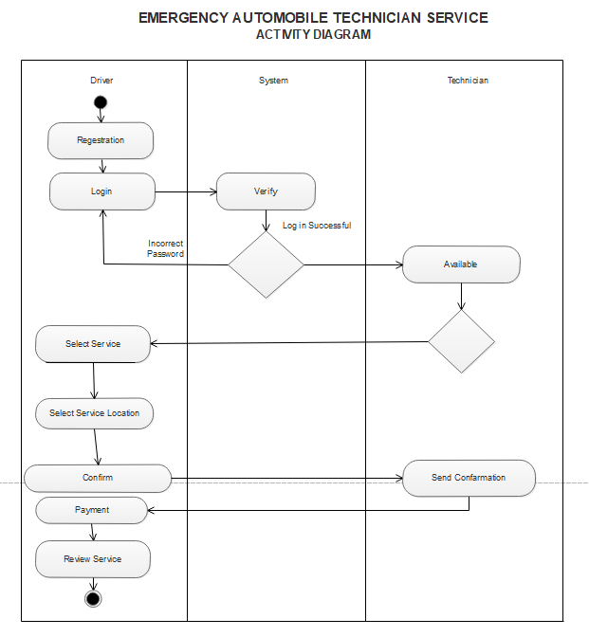
ACTIVITY DIAGRAM

Slide 7
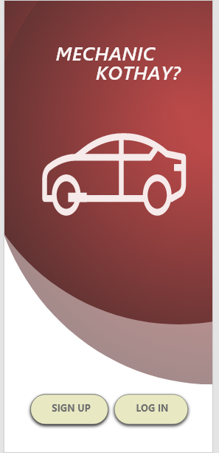
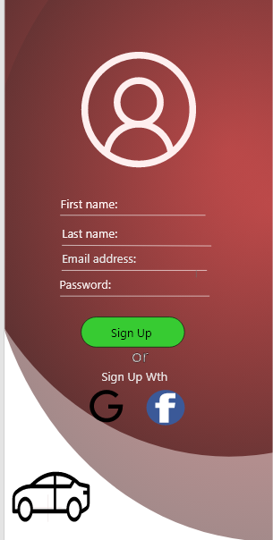
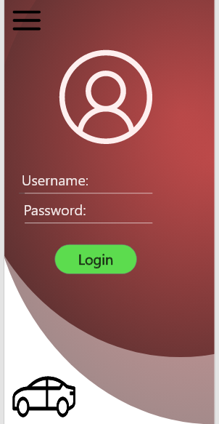
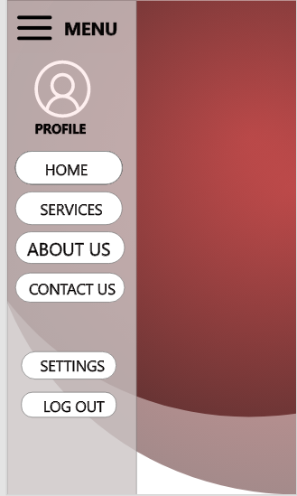
USER INTERFACE OR MOCK DESIGN

Slide 8
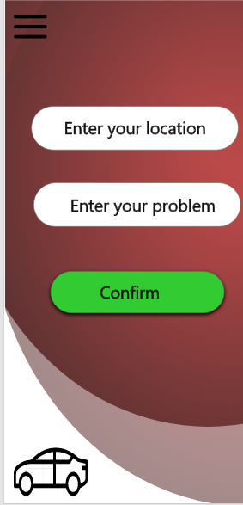
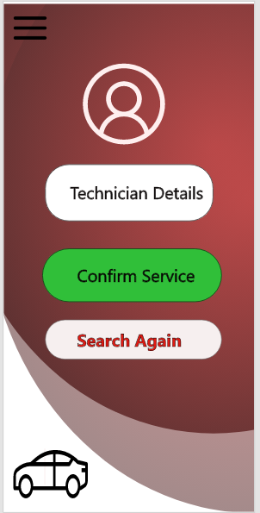
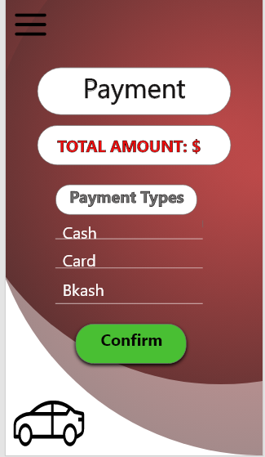
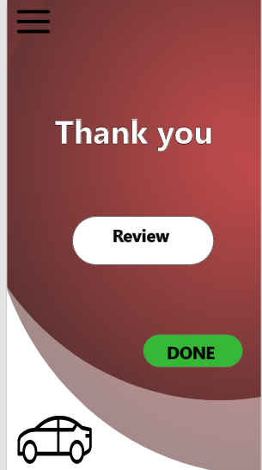
USER INTERFACE OR MOCK DESIGN

Slide 9
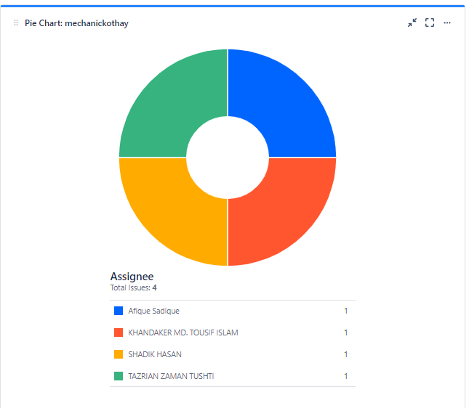
JIRA
LINKS : https://mechanickothay.atlassian.net/secure/Dashboard.jspa?selectPageId=10001

Slide 10
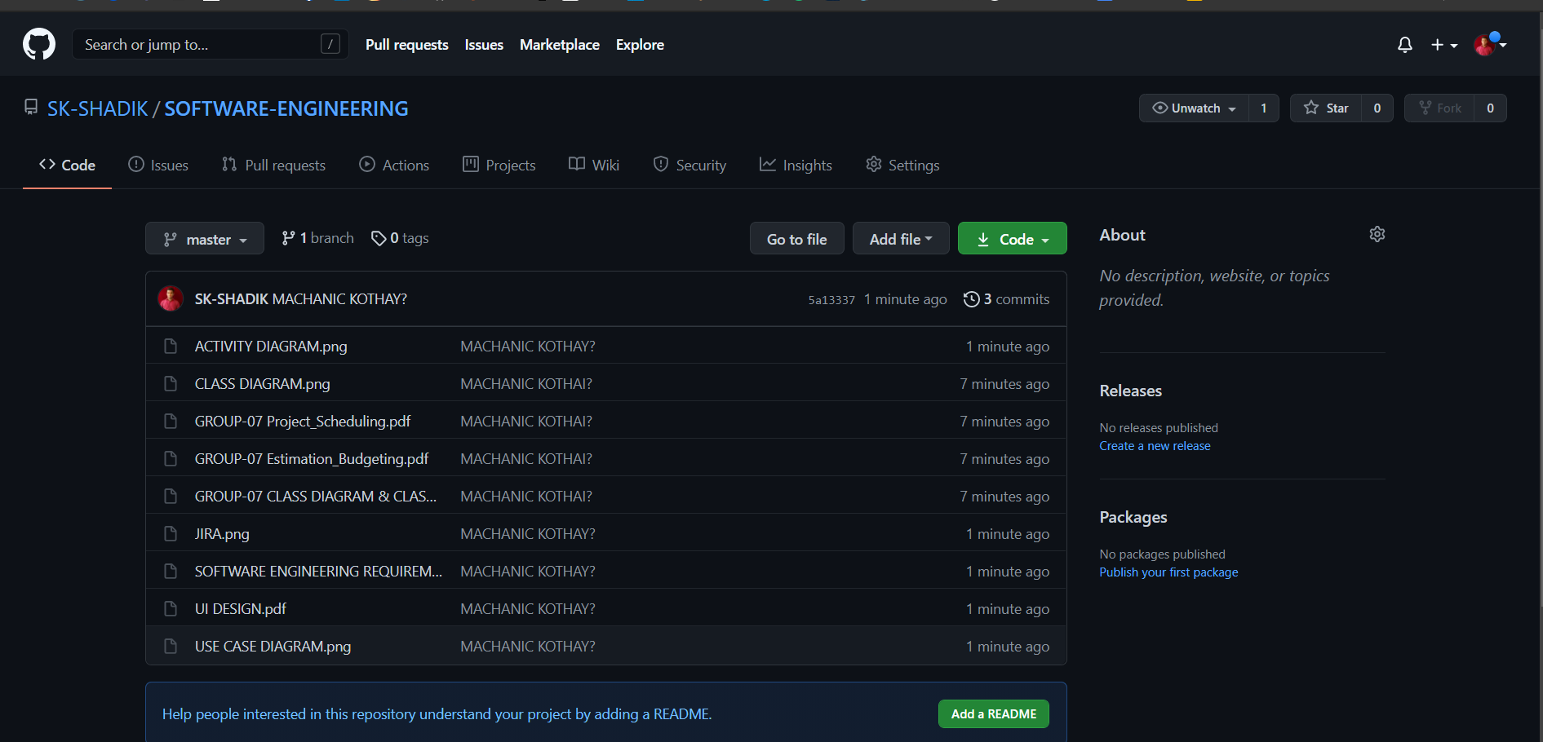
GIT
LINKS : https://github.com/SK-SHADIK/SOFTWARE-ENGINEERING

Slide 11
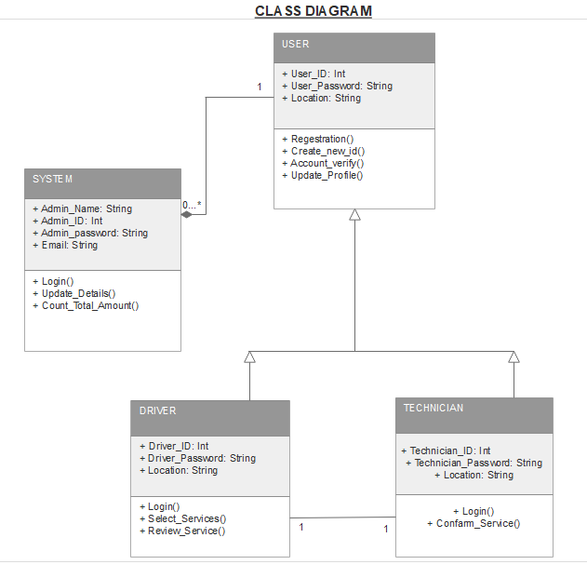
CLASS DIAGRAM

Slide 12
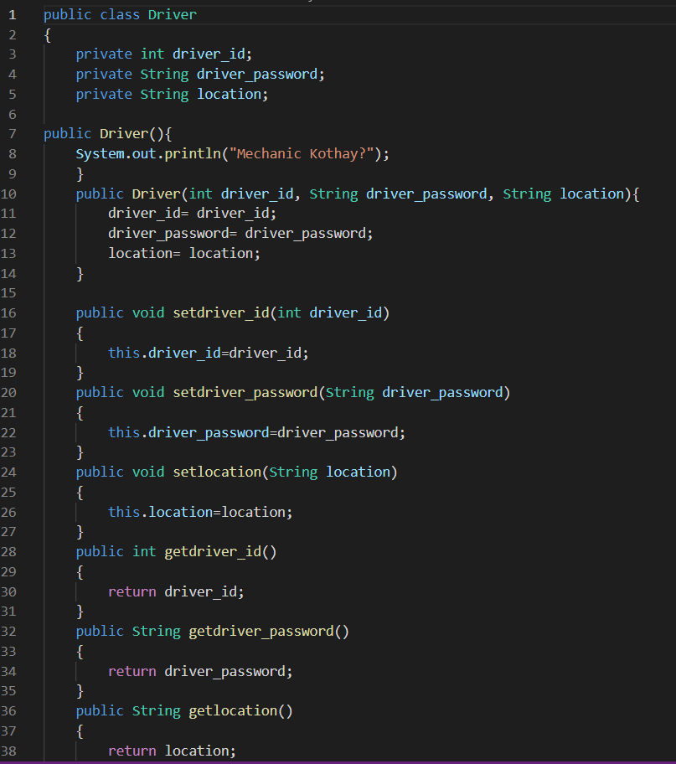
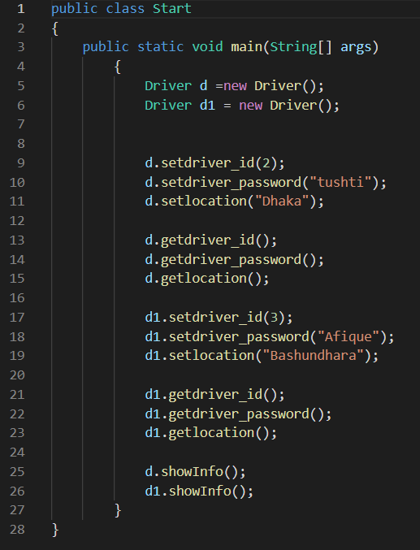
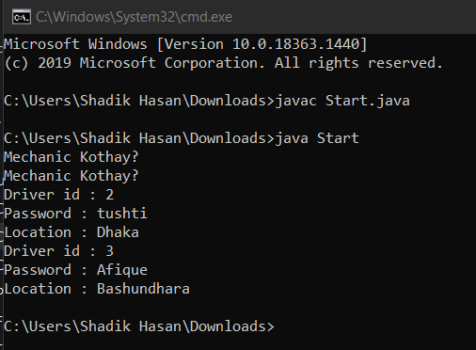
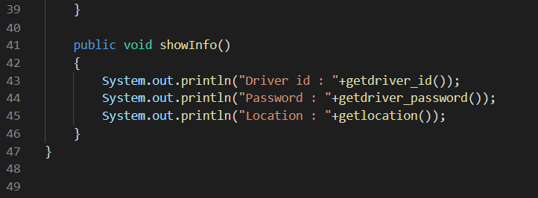
CODE

Slide 13
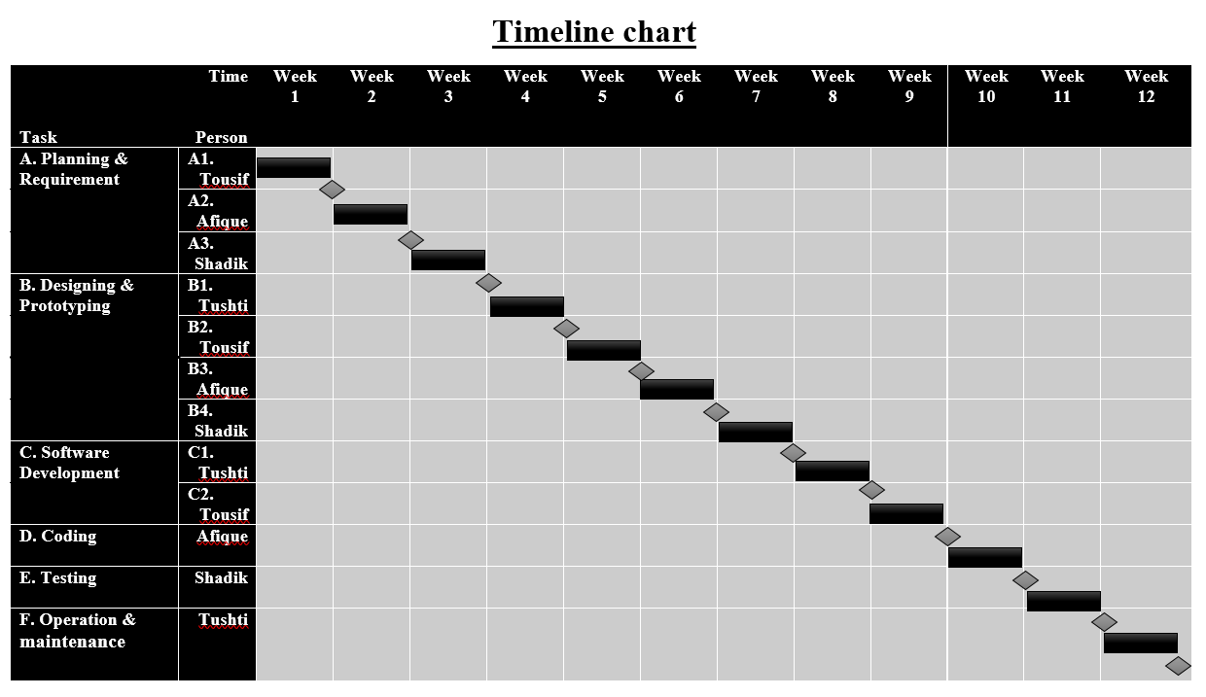
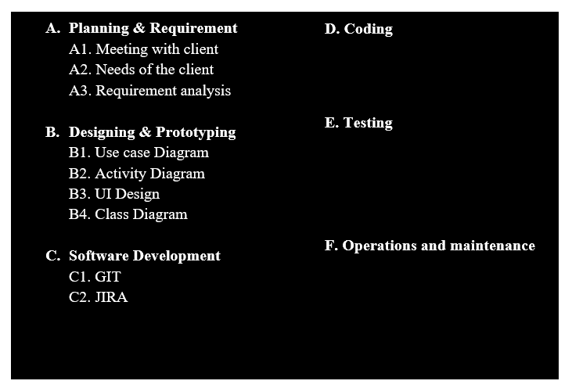
PROJECT SCHEDULING

Slide 14
EFFORT ESTIMATION & BUDGETING
Effort = PM = Coefficient*(SLOC/1000)^P
= 2.4(20000/1000)^1.05
= 55
Development time = DM = 2.50*(PM)^T
= 2.50*(55)^.38
= 11
Required number of people = ST = PM/DM
= 45/11
= 5
Designing & Coding = 11*22*8 [11 month, 22 days , 8h]
= 1936 h
Total sal(day) = 1936*1200 [1h salary =1200tk]
= 2323200 tk [5 day salary] (So, 1 day sal=464640)
Per month salary = (464640/11)
= 42240 tk(1 day)
Requirement Analysis = 15*8*600 [15 days, 600 per h sal]
=72000 tk

Slide 15
EFFORT ESTIMATION & BUDGETING
Maintenance = 2*5*6*2500 [per week 2h, 6mon]
= 150000 tk
Travel Expense = 11*5000
= 55000 tk
Office Rent = 20000*12
= 240000 [per month 20000]
Utilities Expenses = 3500*12
= 42000
Training/Hardware = 3000*12
= 36000
Cost = 2323200 +42240 +72000 +150000 +55000 +240000 +42000
= 2924440 tk
Profit margin = 2924440*15%
= 438666 tk
Pay bill (client) = 33,63,106 tk

Slide 16
CONCLUSION
This project is estimated any kind of the mechanical problems of the vehicles on an emergency basis, which will give the user a safe and secure solution.
This software system is very beneficial to us as it fulfils all the requirements of a software. It will help users to contact with the technicians at any emergency situations.

Slide 17

QUESTION ANSWER SESSION

Slide 18


